Slide 1
DSP Practice Questions & Solutions

Slide 2
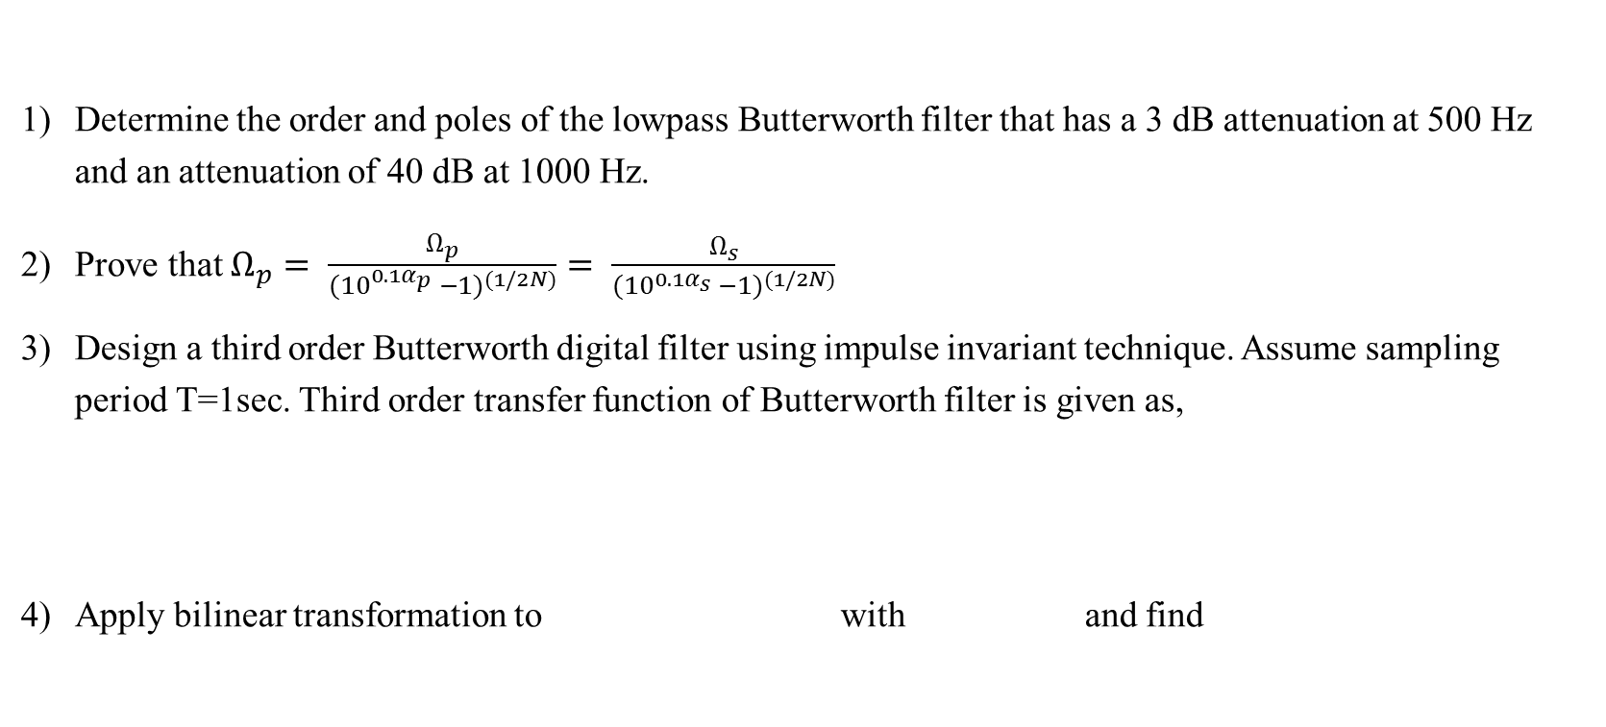
Questions
Determine the order and poles of the lowpass Butterworth filter that has a 3 dB attenuation at 500 Hz and an attenuation of 40 dB at 1000 Hz.
Prove that $Ω_{p}= \frac{Ω_{p}}{{{(10}^{0.1α_{p}} −1)}^{(1/2N)}}= \frac{Ω_{s}}{{{(10}^{0.1α_{s}} −1)}^{(1/2N)}}$
Design a third order Butterworth digital filter using impulse invariant technique. Assume sampling period T=1sec. Third order transfer function of Butterworth filter is given as,
Apply bilinear transformation to withand find

Slide 3
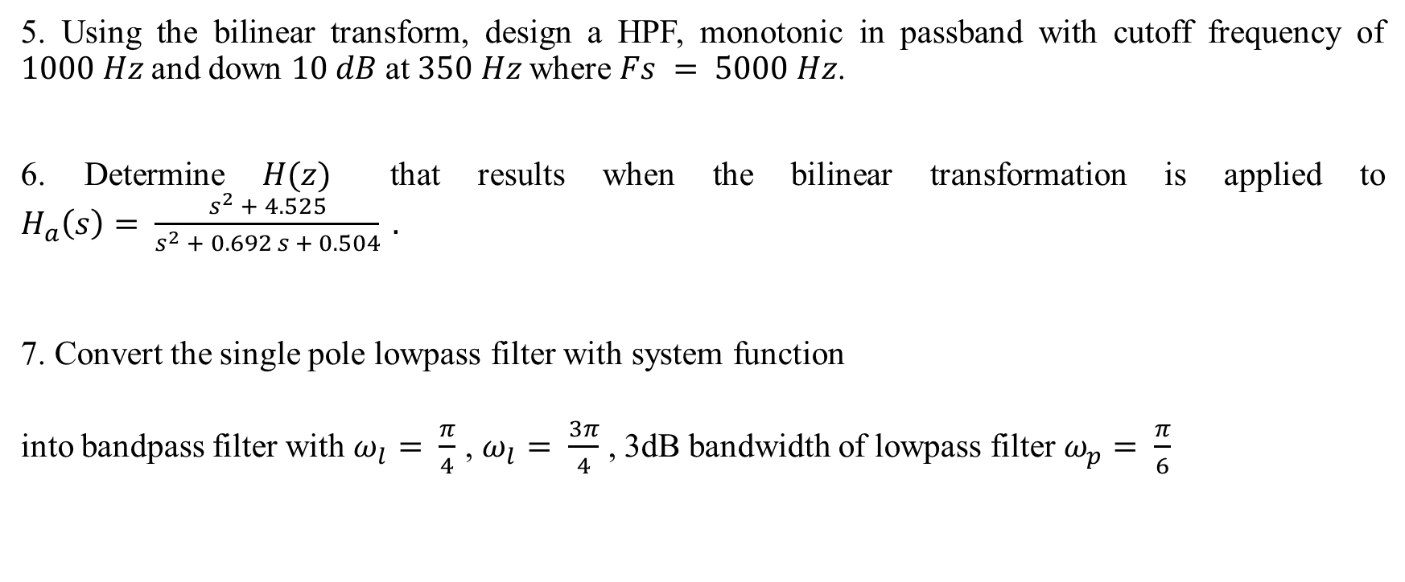
Questions
5. Using the bilinear transform, design a HPF, monotonic in passband with cutoff frequency of $1000 Hz$and down $10 dB$at $350 Hz$where $Fs = 5000 Hz$.
6. Determine $H(z)$ that results when the bilinear transformation is applied to $H_{a}\left(s\right)= \frac{s^{2} + 4.525}{s^{2} + 0.692 s + 0.504} .$
7. Convert the single pole lowpass filter with system function
into bandpass filter with $ω_{l}= \frac{π}{4}$ , $ω_{l}= \frac{3π}{4}$ , 3dB bandwidth of lowpass filter $ω_{p}= \frac{π}{6}$

Slide 4
Questions
8. Determine the Direct Form I and Direct Form II (Canonic) structure of the IIR Filter described by the following difference equation:

Slide 5
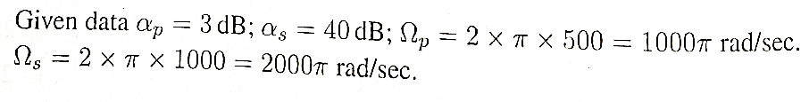
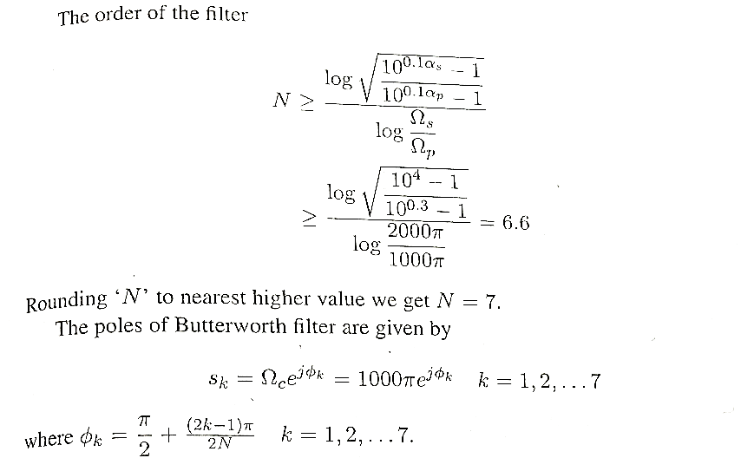
Solution1

Slide 6
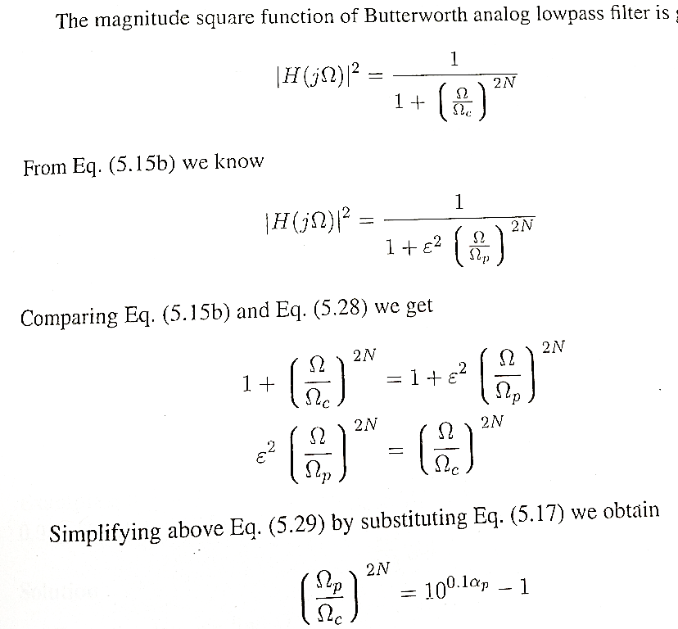
Solution2

Slide 7
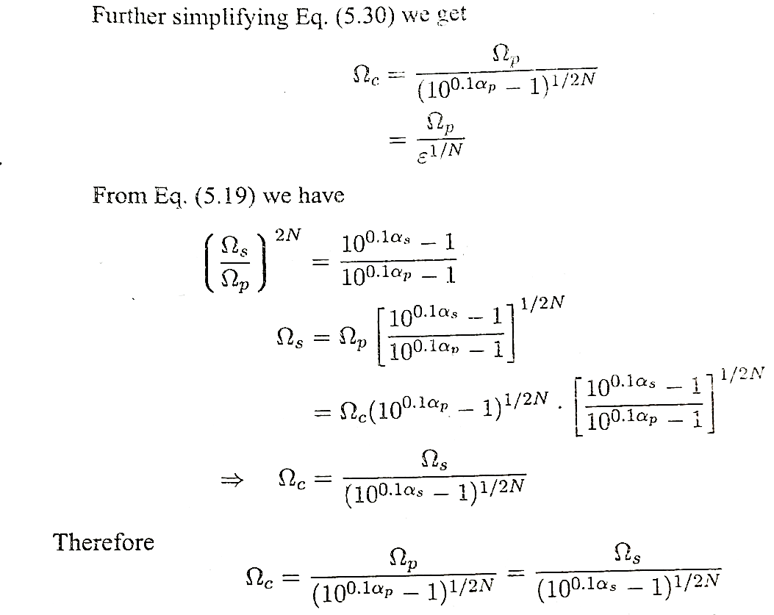
Solution2

Slide 8
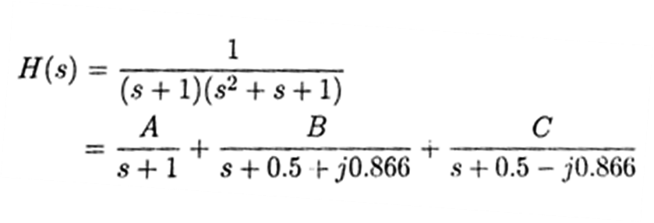
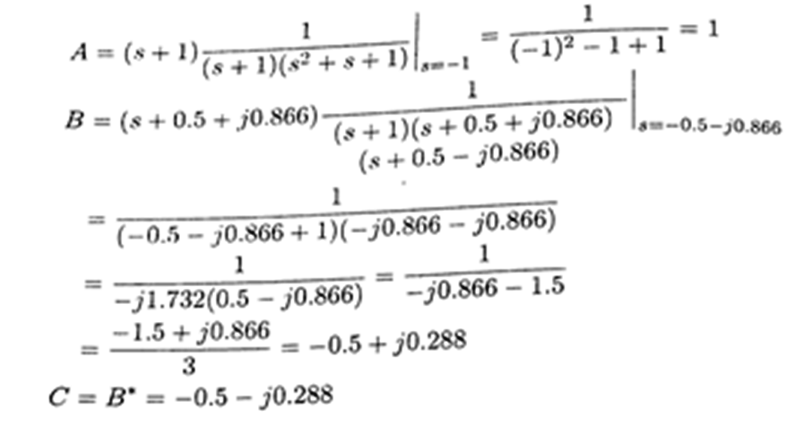
Solution 3

Slide 9
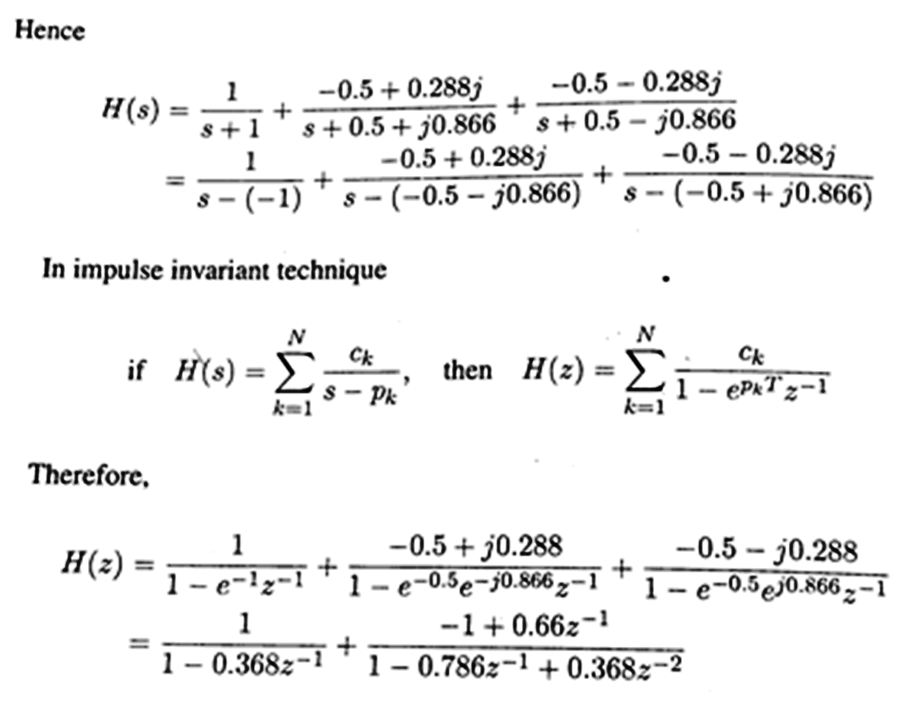
Solution 3

Slide 10
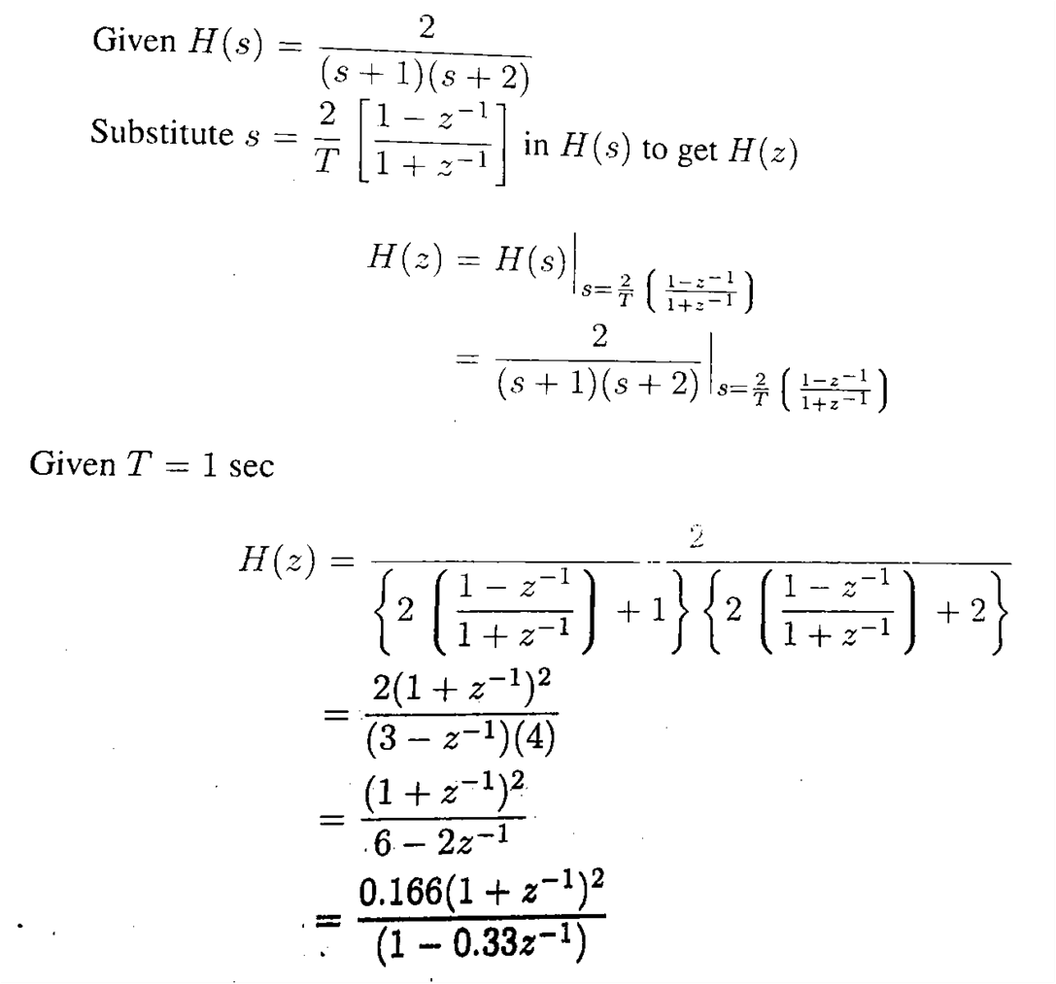
Solution 4

Slide 11
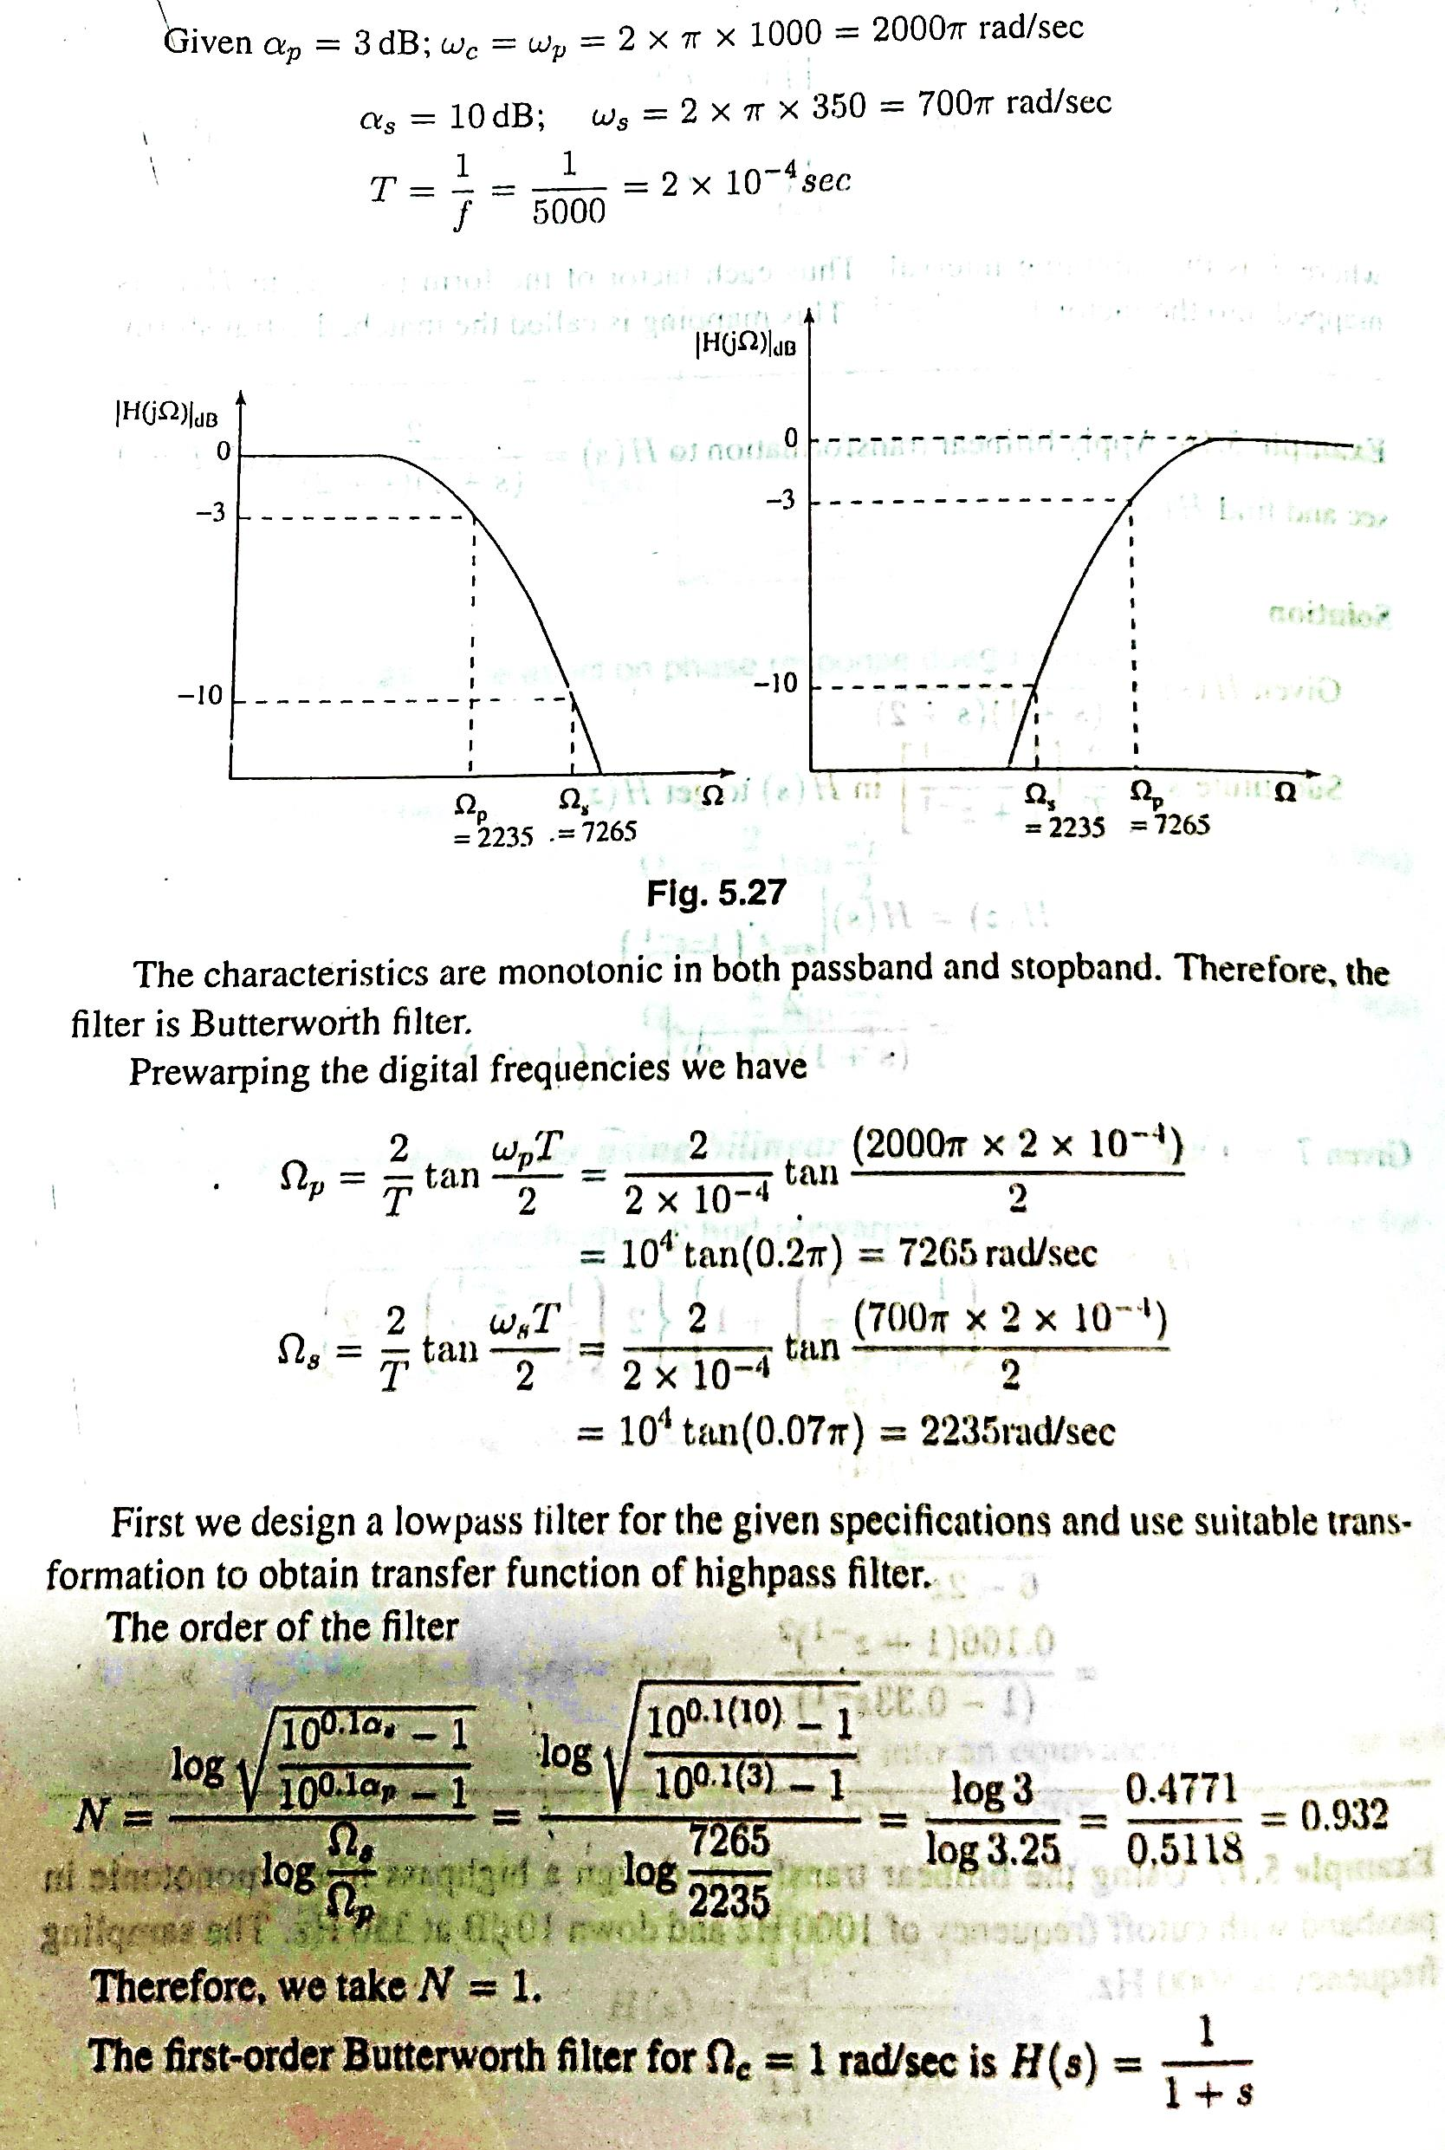
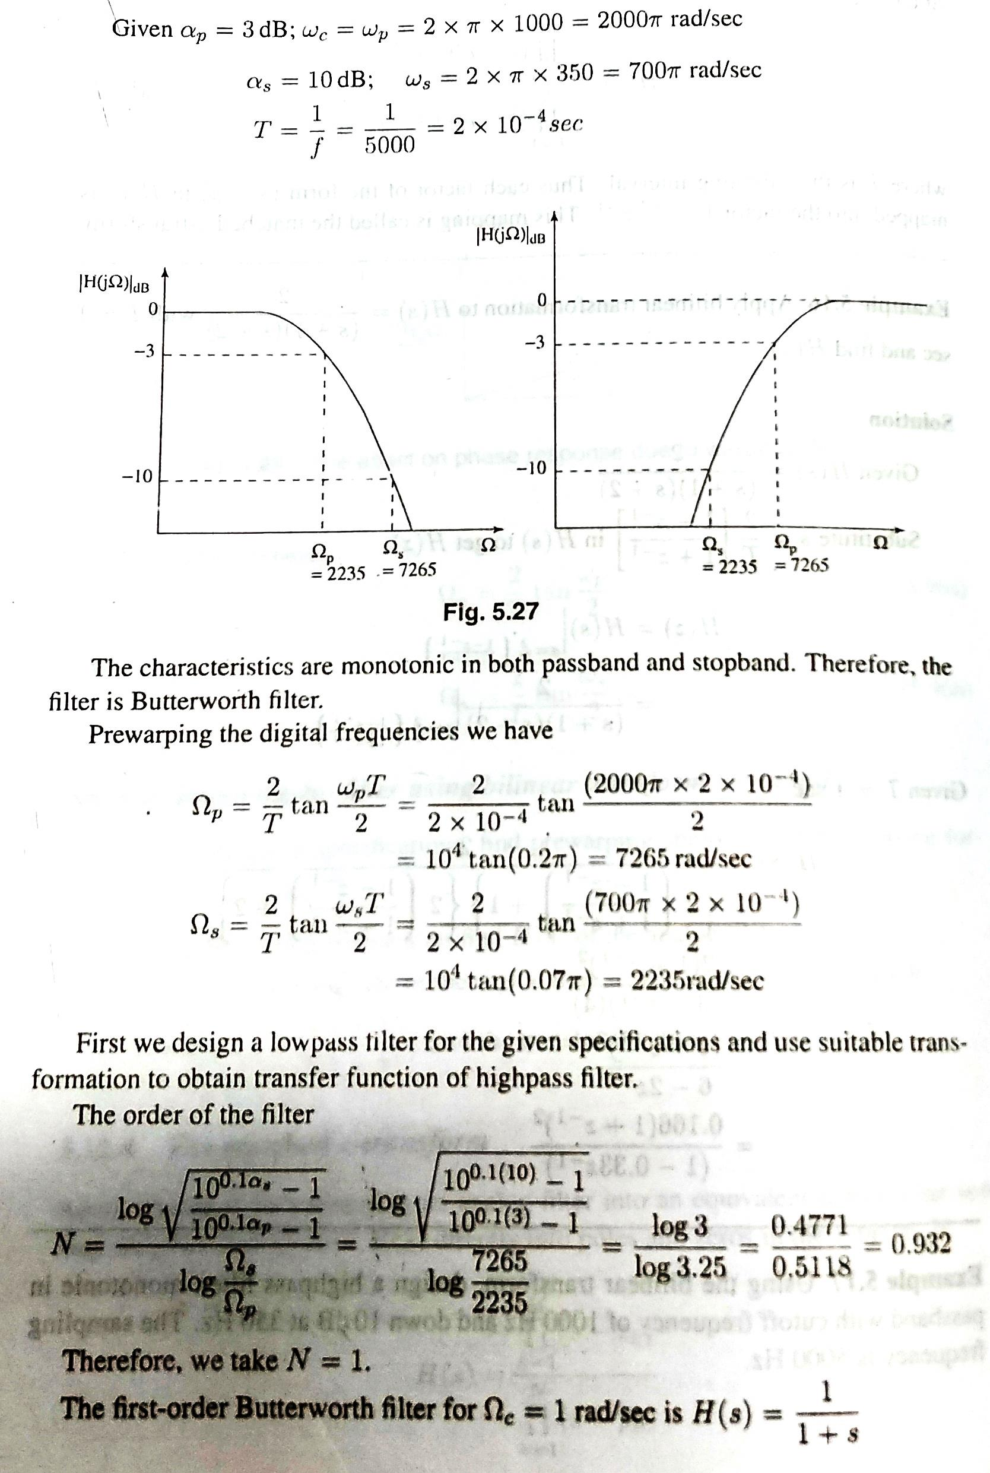
Solution 1
Solution 5

Slide 12
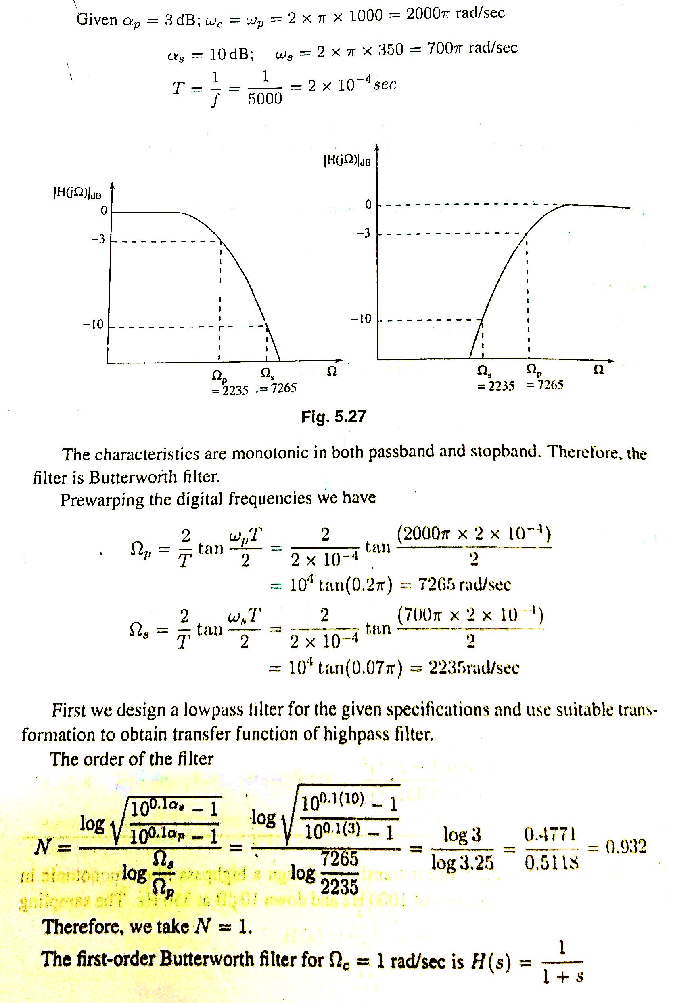
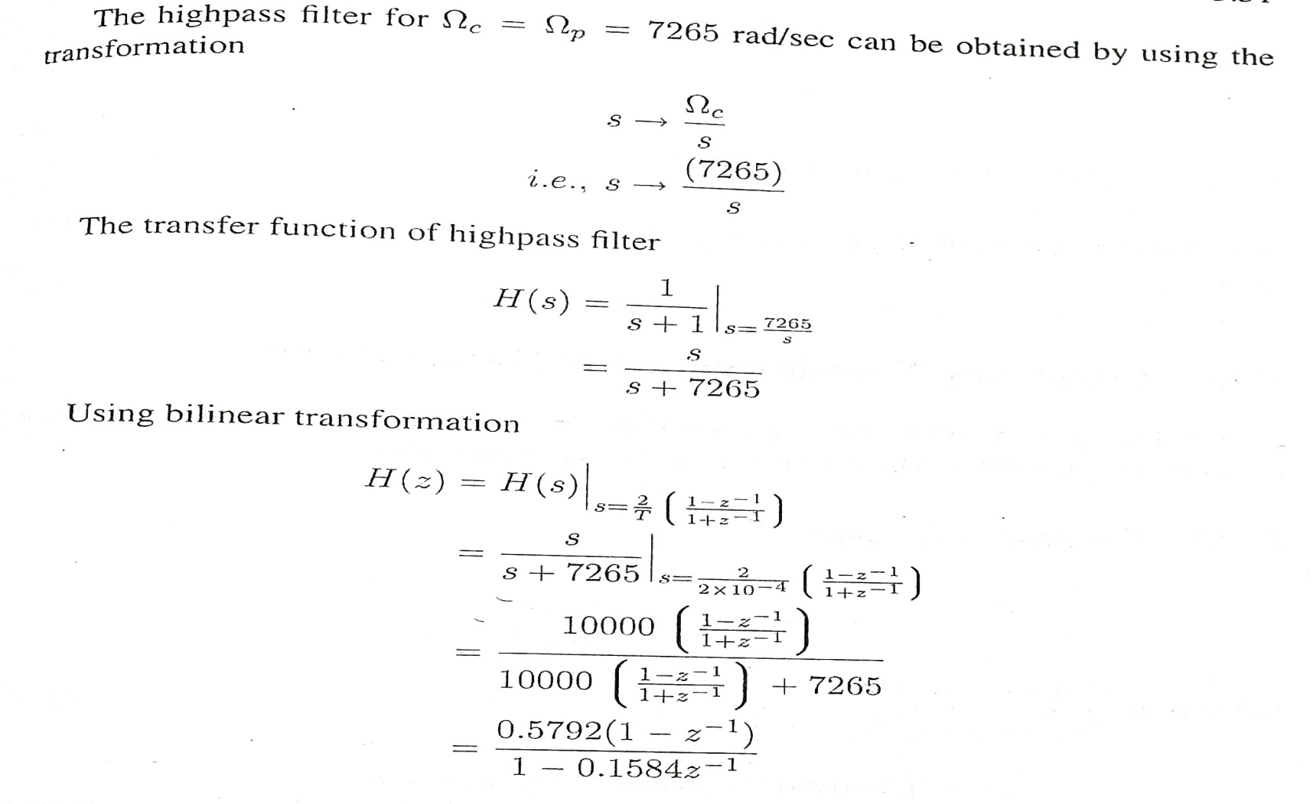
Solution 5

Slide 13
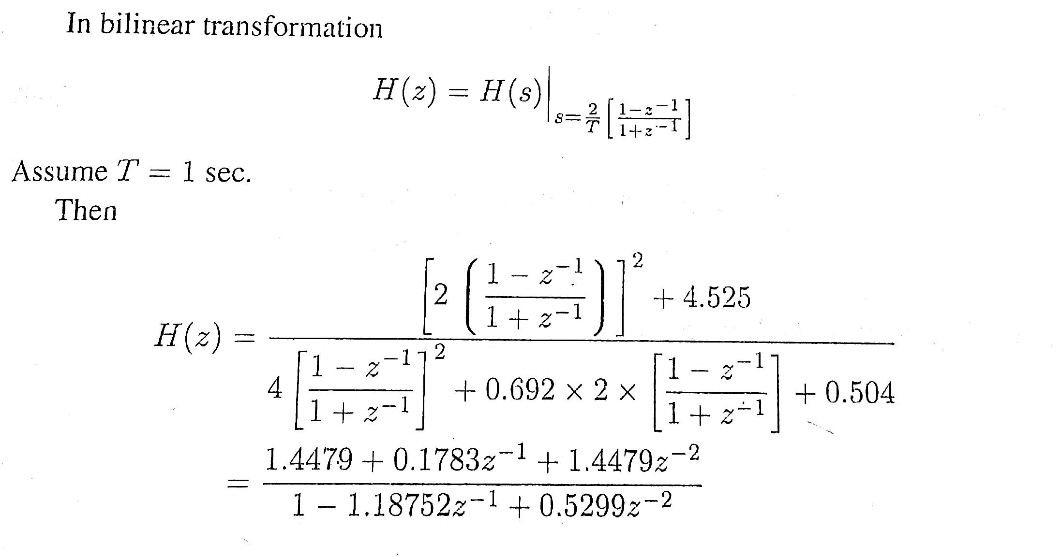
Solution 6

Slide 14
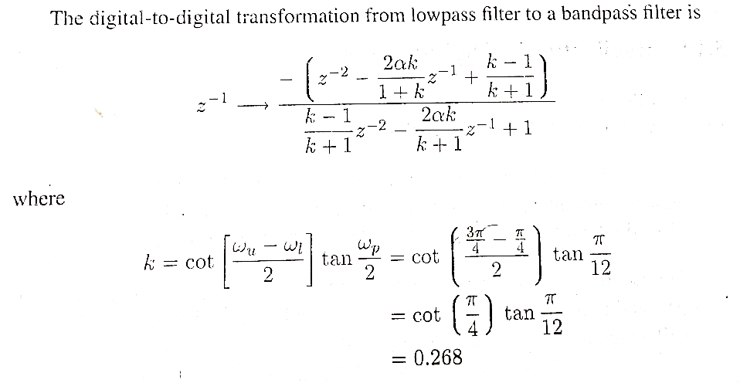
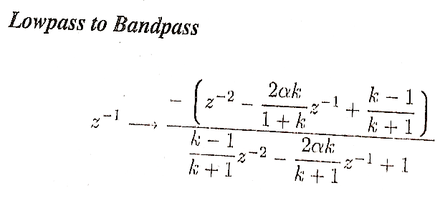
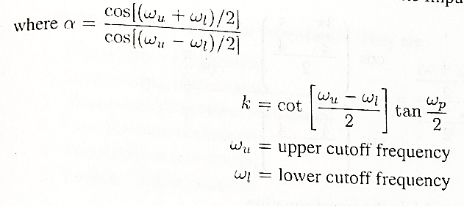
Solution 7

Slide 15
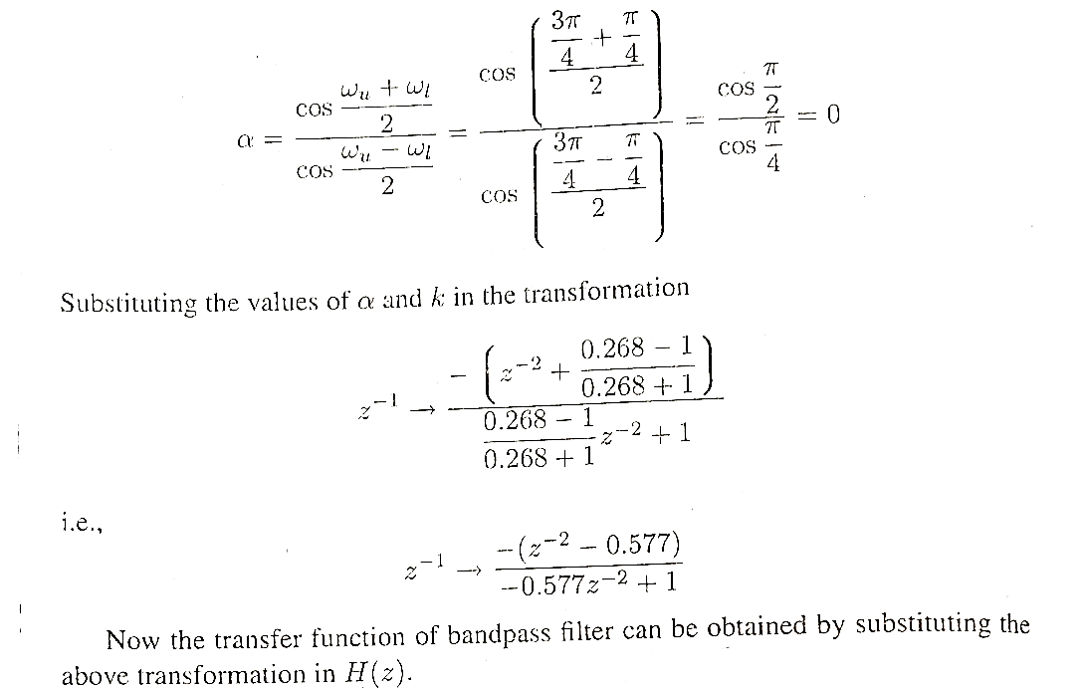
Solution 7

Slide 16
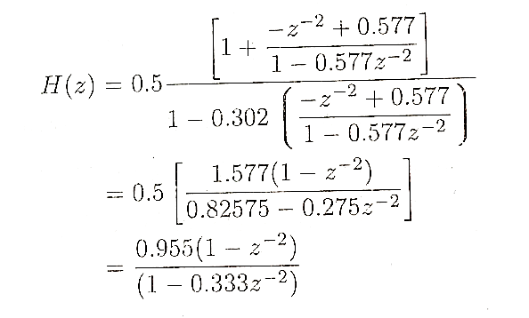
Solution 7

Slide 17
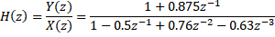
Solution 8
The transfer function of the given difference equation can be written as:
The direct form I structure is given as:

Slide 18
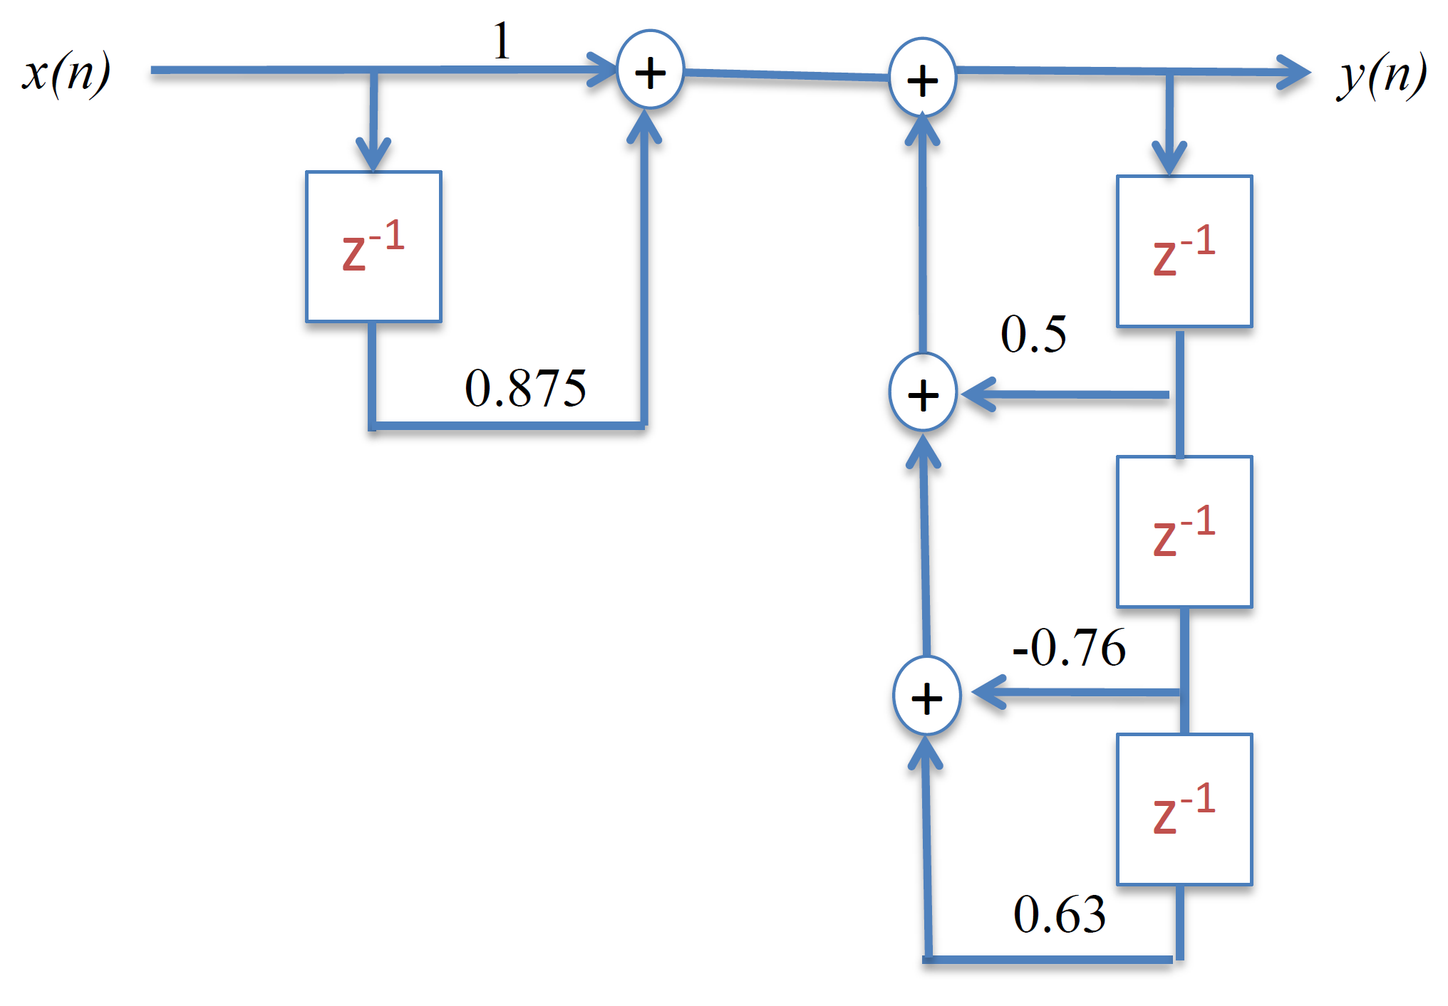
Direct Form I realization

Slide 19
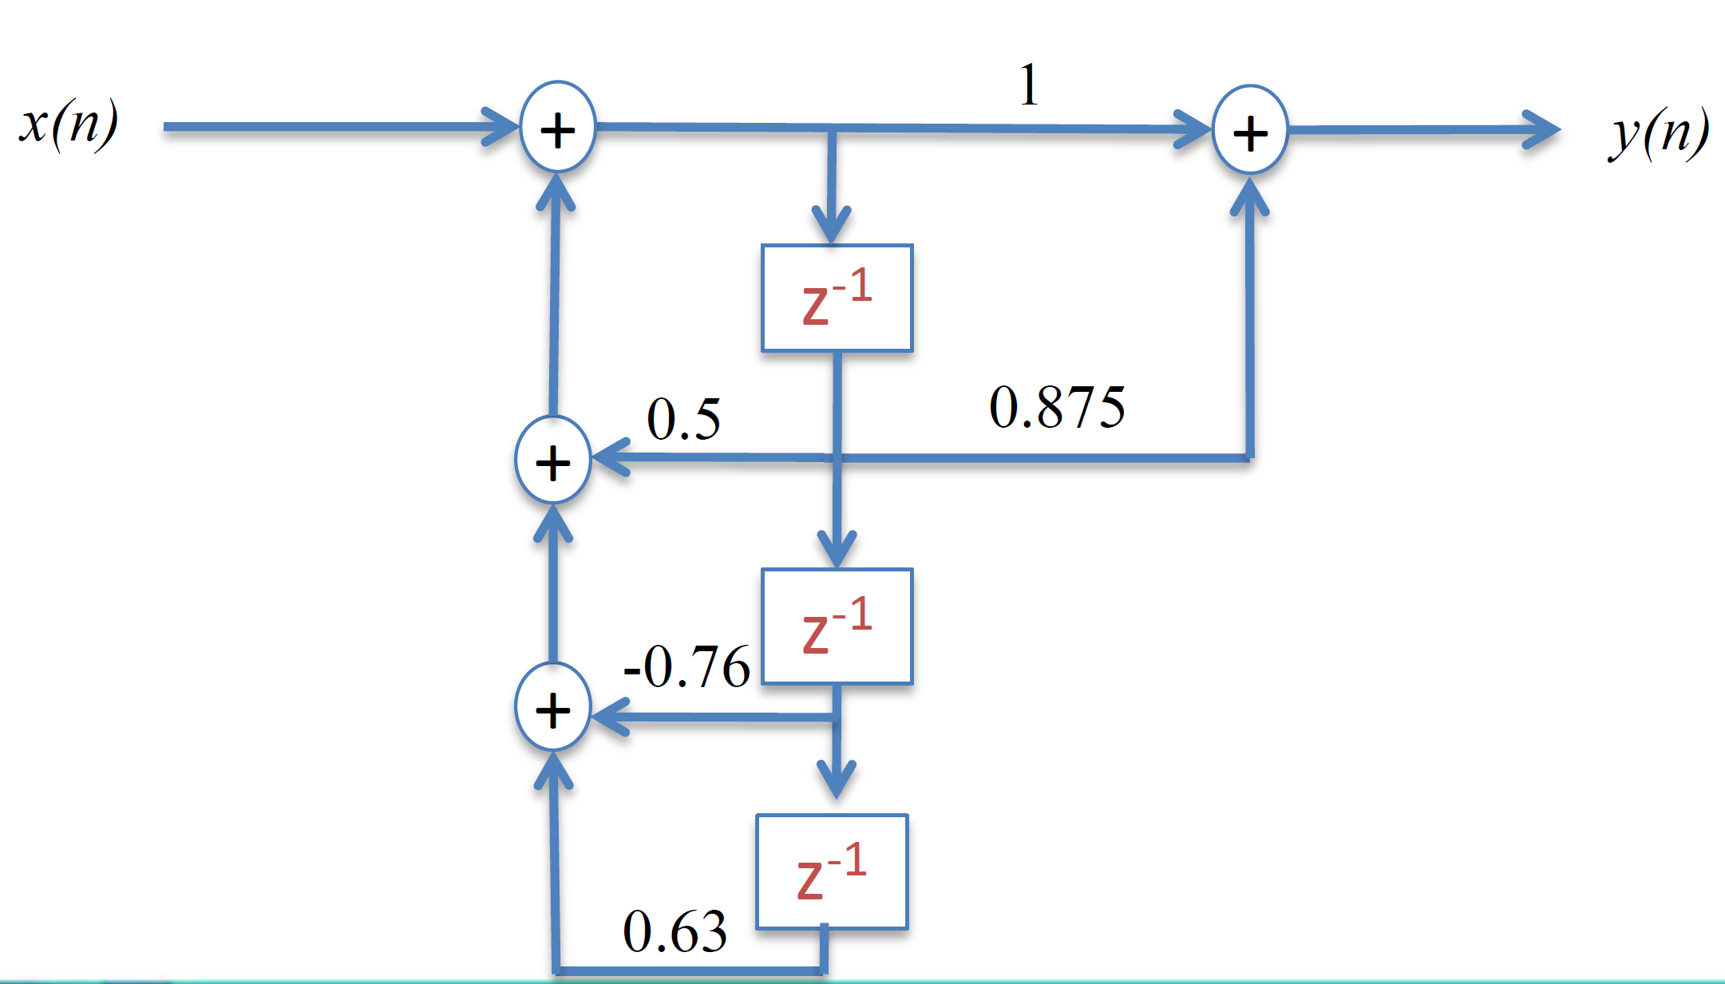
Direct Form II realization

